Slide 1
Software Testing
What is software testing ?
Why do we need to test ?
Cannot we live without testing ?
How do we handle software bugs reported by the customers ?
Who should work hard to avoid frustrations of failures ?
The developers normally ask :
How did these bugs escape from testing ?

Slide 2

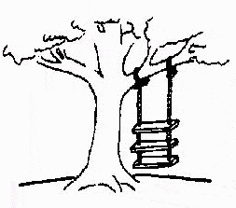
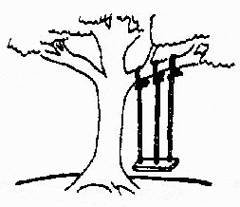
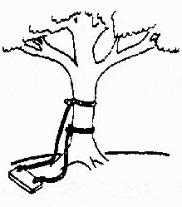
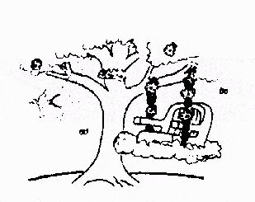
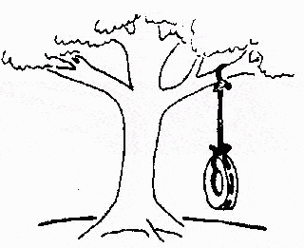
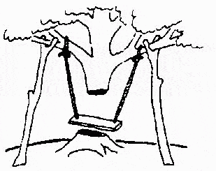
Status of Software Engineering
This is how the problem is solved now
The requirements specification was defined like this
The developers understood it in that way
This is how the problem was solved before.
This is how the program is described by marketing department
This, in fact, is what the customer wanted …
That is the program after debugging

Slide 3

Some Software failures
Ariane 5
It took the European Space Agency 10 years and $7 billion to produce Ariane 5, a giant rocket capable of hurling a pair of three-ton satellites into orbit with each launch and intended to give Europe overwhelming supremacy in the commercial space business.
The rocket was destroyed after 39 seconds of its launch, at an altitude of two and a half miles along with its payload of four expensive and uninsured scientific satellites.

Slide 4

Some Software failures
When the guidance system’s own computer tried to convert one piece of data the sideways velocity of the rocket from a 64 bit format to a 16 bit format; the number was too big, and an overflow error resulted after 36.7 seconds. When the guidance system shutdown, it passed control to an identical, redundant unit, which was there to provide backup in case of just such a failure. Unfortunately, the second unit , which had failed in the identical manner a few milliseconds before.

Slide 5


Some Software failures
Y2K problem:
It was simply the ignorance about the adequacy or otherwise of using only last two digits of the year.
The 4 digit date format, like 1964, was shortened to 2 digit format, like 64.

Slide 6
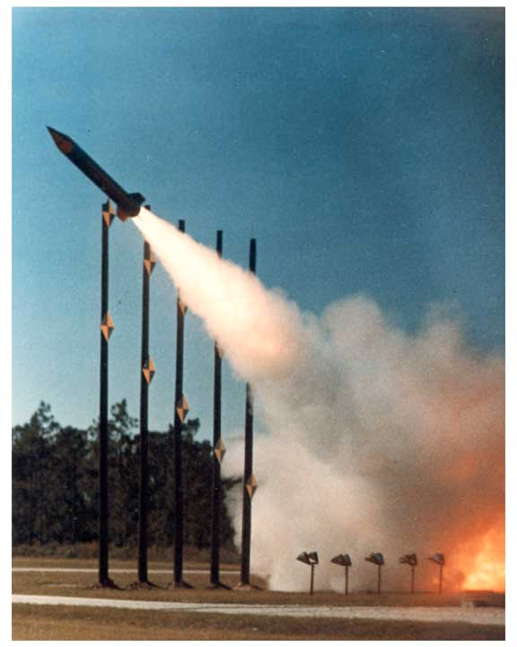
Some Software failures
The Patriot Missile
First time used in Gulf war
Used as a defence from Iraqi Scud missiles
Failed several times including one that killed 28 US soldiers in Dhahran, Saudi Arabia
Reasons:
A small timing error in the system’s clock accumulated to the point that after 14 hours, the tracking system was no longer accurate. In the Dhahran attack, the system had been operating for more than 100 hours.

Slide 7

Some Software failures
The Space Shuttle
Part of an abort scenario for the Shuttle requires fuel dumps to lighten the spacecraft. It was during the second of these dumps that a (software) crash occurred.
...the fuel management module, which had performed one dump and successfully exited, restarted when recalled for the second fuel dump...

Slide 8
Experience of Windows XP
Released on October 25,2001
Same day company posted 18 megabytes of patches on its website for bug fixes, compatibility updates and enhancements.

Slide 9
Testing Process
It is basically the process of testing the newly developed software, prior to actual use.
Good testing involves much more than just running the program a few times to see whether it works as per specifications.

Slide 10
What is Software testing ?
Consider a program minimum() that reads a set of integers and prints the smallest integer.

Slide 11
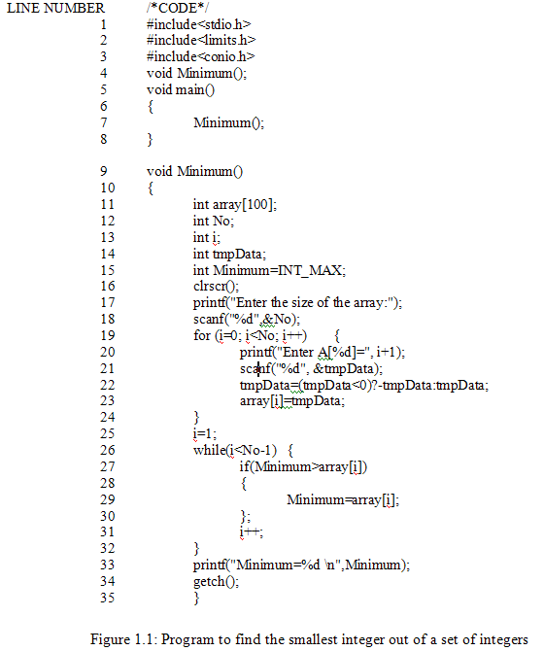

Slide 12
What is Software testing ?
.
Some test cases
Sr. No. | Inputs |  | Expected output | Observed output | Match ?
 | Size | Set of integers
1
2
3
4
5
6
7
8
5
6,9,2,16,19
2
2
Yes
7
96,11,32,9,39,99,91
9
9
Yes
7
31,36,42,16,65,76,81
16
16
Yes
6
28,21,36,31,30,38
21
21
Yes
6
106,109,88,111,114,116
88
88
Yes
6
61,69,99,31,21,69
21
21
Yes
4
6,2,9,5
2
2
Yes
4
99,21,7,49
7
7
Yes

Slide 13
What is testing ?
Testing is the process of demonstrating that errors are not present.
2. The purpose of testing is to show that a program performs its intended functions correctly.
3. Testing is the process of establishing confidence that a program does what it is supposed to do.
Incorrect
Testing
Value to the program

Slide 14
Definition
Thus, most appropriate definition is :
“Testing is the process of executing a program with the intent of finding faults.”
Our input selection should have a higher probability of finding faults.

Slide 15
We again consider the minimum() program and concentrate on some typical and critical situations :
(i) A very short list (of inputs) with the size of 1,2 or 3 elements.
(ii) An empty list i.e. of size 0.
(iii) A list where the minimum element is the first or last element.
(iv) A list where the minimum element is negative.
(v) A list where all elements are negative.
Cont….

Slide 16
(vi) A list where some elements are real numbers.
(vii) A list where some elements are alphabetic characters.
(viii) A list with duplicate elements.
(ix) A list where one element has a value greater than maximum permissible limit of an integer.

Slide 17
In the previous table, we have selected elements in every list to cover essentially the same situation :
A list of moderate size.
Containing all positive integers.
Minimum is somewhere in the middle.

Slide 18
Some critical / typical situations of program Minimum()
Case number with description | Inputs |  |  | Expected o/p | Observed o/p | Match ?
 |  | Size | Set of Integers
a b c d e f
1 2 2 3 3 3
90
12,10
10,12
12,14,36
36,14,12
14,12,36
90 10 10 12 12 12
2147483647
2147483647
2147483647
14
14
12
No No No No No Yes
Case 1
A very short list with size 1,2 or 3
Case 2
An empty list i.e. of size 0
a
0
----
Error message
2147483647
No
Case 3
A list where minimum element is first or last element
a
b
5
5
10,23,34,81,97
97,81,34,23,10
10
10
23
23
No
No
Case 4
A list where minimum element is negative
a
b
4
4
10,-2,5,23
5,-25,20,36
-2
-25
2
20
No
No
Cont….

Slide 19
Case number with description | Inputs |  |  | Expected o/p | Observed o/p | Match ?
 |  | Size | Set of Integers
Case 5
A list where all elements are negative
a
b
5
5
-23,-31,-45,-56,-78
-6,-203,-56,-78,-2
-78
-203
31
56
No
No
Case 6
A list where some elements are real numbers
a
b
5
5.4
12,34.56,6.9,62.14,19
2,3,5,6,9
6.9
2
34 (Program does not take values for index 3,4,5)
838993460 (Program does not take any array value)
No
No
Case 7
A list where some elements are characters
a
b
5
1I
23,2 I,26,6,9
2,3,4,9,6,5,11,12,14,21,22
6
2
2 (No value for index 3,4,5)
2147483647 (Program does not take any index value)
No
No
Case 8
A list with duplicate elements
a
b
5
5
3,4,6,9,6
13,6,6,9,15
3
6
4
6
No
Yes
Case 9
Value greater than maximum permissible limit of an integer
a
5
530,4294967297,23, 46,59
23
1
No

Slide 20
What are the possible reasons for so many failures ?
Possible reasons
Case 1
A very short list with size 1,2 or 3
While handling the minimum, the base value of the index and / or end value of the index of the usable array has not been handled properly.
See line no. 25 & 26
Case 2
An empty list i.e. of size 0
Program proceeds without checking the size of the array.
See line 18 & 19
Case 3
A list where minimum element is the first or last element
Same as for case 1
Case 4
A list where minimum element is negative
The program converts all negative integers into positive integers
See line no. 22
Case 5
A list where all elements are negative
Same as for case 4
Cont….

Slide 21
Possible reasons
Case 6
Some elements are real numbers
Scanf() has unpredictable behaviour for inputs not according to specified format.
Case 7
Some elements are alphabetic characters
Same as for case 6
Case 8
A case with duplicate elements
Same as case 1
We are getting correct results because minimum value is in the middle of the list and all values are positive.
Case 9
A list with one value greater than maximum permissible limit of an integer
This is hardware dependent problem. This is the case of the overflow of maximum permissible value of the integer. Here, 32 bits integers are used.

Slide 22
Reasons for observed outputs
Cases
Observed
output
Remarks
1 (a)
1 (b)
1 (c)
2147483647
2147483647
2147483647
The program has ignored first & last values of the list. This is the maximum value of a 32 bit integer to which variable minimum is initialized.
1 (d)
1 (e)
14
14
The program has ignored first and last value of the list. Middle value is 14.
1 (f)
12
Ignored first & last value. Fortunately, middle value is minimum & thus the result is correct.
2 (a)
2147483647
Same as 1 (a)
3 (a)
3 (b)
23
23
Ignored first & last value. 23 is the minimum value in the remaining lsit.
4 (a)
4 (b)
2
20
Ignored first & last value. It has also converted negative integer(s) to positive integer(s).
Cont….

Slide 23
Cases
Observed
output
Remarks
5 (a)
5 (b)
31
56
Same as case 4
6 (a)
6 (b)
34
858993460
After getting ‘.’ of 34.56, program was terminated & 34 was displayed.12 was ignored due to first value:
For 6(b): Garbage value
7 (a)
7 (b)
2
2147483647
After getting ‘I’, program terminated adruptly.
Maximum value of integer
8 (a)
8 (b)
4
6
Same as case 3
Fortunately result is correct. Although, first & last value are ignored.
9 (a)
1
The program displays this value due to the overflow of the 32 bit signed integer data type used in the program

Slide 24
Modification in the program minimum ()
1. The program has ignored the first & last values of the list.
Line no. 25 & 26
Two faults
25 “i=1;” “i=0;”
26 “while (i<No-1)” “while (i<=No-1)”
2. The program proceeds without checking the size of the array
Line no. 17 & 18
After line 18
If (No <=0)
{
printf (“Invalid size specified”);
}

Slide 25
3. Program has converted negative values to positive values
Line no. 22
Delete this line
Modified program in fig. 2

Slide 26
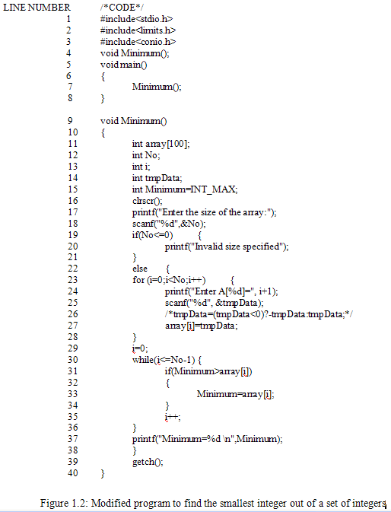

Slide 27
Results of modified program
Case number with description | Inputs |  |  | Expected o/p | Observed o/p | Match ?
 |  | Size | Set of Integers
a b c d e f
1 2 2 3 3 3
90
12,10
10,12
12,14,36
36,14,12
14,12,36
90 10 10 12 12 12
90
10
10
12
12
12
Yes
Yes
Yes
Yes
Yes
Yes
Case 1
A very short list with size 1,2 or 3
Case 2
An empty list i.e. of size 0
a
----
Error message
Error message
0
Yes
Case 3
A list where minimum element is first or last element
a
b
5
5
10,23,34,81,97
97,81,34,23,10
10
10
10
10
Yes
Yes
Case 4
A list where minimum element is negative
a
b
4
4
10,-2,5,23
5,-25,20,36
-2
-25
-2
-25
Yes
Yes
Cont….

Slide 28
Case number with description | Inputs |  |  | Expected o/p | Observed o/p | Match ?
 |  | Size | Set of Integers
Case 5
A list where all elements are negative
a
b
5
5
-23,-31,-45,-56,-78
-6,-203,-56,-78,-2
-78
-203
-78
-203
Yes
Yes
Case 6
A list where some elements are real numbers
a
b
5
5.4
12,34.56,6.9,62.14,19
2,3,5,6,9
6.9
2
12
838993460 (Program does not take any array value)
No
No
Case 7
A list where some elements are characters
a
b
5
1I
23,2 I,26,6,9
2,3,4,9,6,5,11,12,14,21,22
6
2
2 (No value for index 3,4,5)
2147483647 (Program does not take any index value)
No
No
Case 8
A list with duplicate elements
a
b
5
5
3,4,6,9,6
13,6,6,9,15
3
6
3
6
Yes
Yes
Case 9
Value greater than maximum permissible limit of an integer
a
5
530,4294967297,23, 46,59
23
1
No

Slide 29
Case 6 & case 7 are failed due to scanf() function parsing problem
Do not use scanf()
If use scanf(), display a warning message for the user before using scanf()

Slide 30
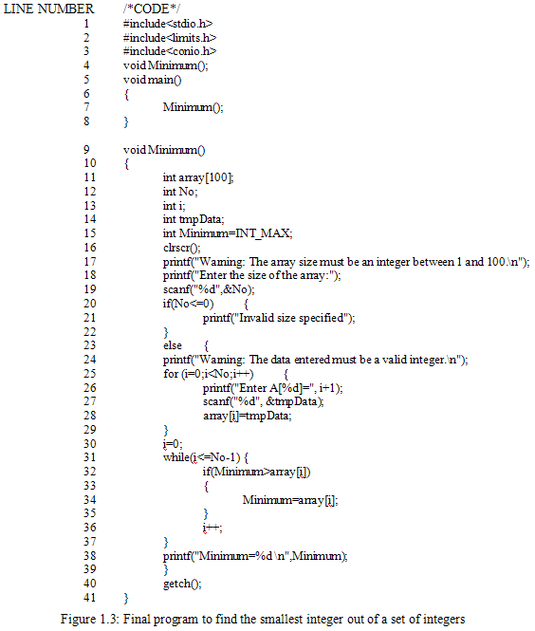

Slide 31
Objective
Objective is to identify weak areas.
Most appropriate definition is :
Testing is the process of executing a program with the intent of finding faults.

Slide 32
Why should we test ?
Software testing is expensive
not testing is more expensive and dangerous
Running a car without brakes
How much testing ?
Do we have methods to know it?
Do we have techniques to quantify it ?

Slide 33
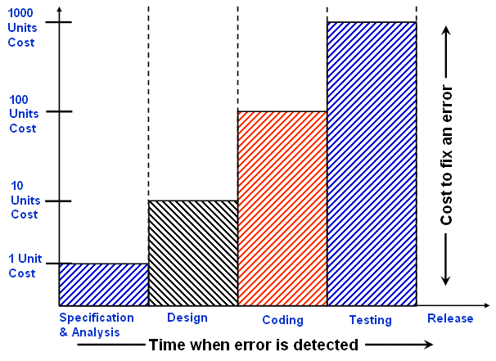
The cost of fix errors increases drastically from specification phase to test phase & then to maintenance phase.

Slide 34
Who should do testing ?
Team work
Depend on complexity & size of the project
Developers should have a reduced role in testing
Testing persons should be curious, critical but non judge mental and good communicators.
Testers should ask questions that developers might find not be able to ask themselves or are awkward, irritating, insulting or even threatening to the developers.

Slide 35
How is the software ?
How good is it ?
How do you know it works ? What evidence do you have ?
What are critical & weak areas & why ?
What are serious design issues ?
Say anything about complexity ?
Most of the times, testing persons are different from developers. Developers provide guidelines during testing.

Slide 36
Role of Persons
Sr. No. | Persons | Roles
1
2
3
4
5
Customer
Provides funding, give requirements, approve changes & some test results.
Project Manager
Plans & manages the project.
Software developer (s)
Design, codes & builds the software, participates in code reviews & testing, fixes bugs, defects & short comings.
Testing
Co-ordinator (s)
Create test plans & test specifications based on the requirements and functional and technical documents.
Testing persons (s)
Execute the tests and documents results.

Slide 37
What should we test ?
We should test the program’s responses to every possible input.
All valid inputs
Invalid inputs
Suppose a program requires two 8 bits integers as inputs.
Total combinations = 2⁸ x 2⁸
Time required to execute a test case = 1second
Total time = 18 hours

Slide 38
How to choose reasonable number of test cases out of large pool of test cases?
What is the bottom line for testing?
Execute every statement at least once
Execute every possible path at least once
Execute every exit of branch statement at least once

Slide 39
Executing every statement of the program at least once may seem to be a reasonable goal. However many portions of the program may be missed with this type of criteria. Consider the following piece of code:
If (x>0)
{
a=a+b;
}
If (y>10)
{
c=c+d;
}

Slide 40
This code can be represented graphically as:
A
Line Numbers | Symbol for representation
1
A
C
B
2,3,4
B
5
C
6,7,8
D
E
D
end
E

Slide 41
The possible paths are: ACE, ABCE, ACDE and ABCDE
However if we choose x=9 and y=15, all statements are covered. Hence only one test case is sufficient for 100% statement coverage. But we have missed other three paths. Therefore this coverage may not be sufficient, even that may also be difficult to achieve in the real life programs.

Slide 42
Another dimension is to execute all possible paths of the program.
A program path can be traced through the code from the start of the program to program termination. Two paths differ if the program executes different statements in each, or executes the same statements but in different order. A program may have many paths.

Slide 43
Sequences
B
A
F
D
G
C
X
EXIT
H
E
I
< 20 times
through the
loop
Here’s an example that shows that there are too many paths to test in even a fairly simple program. This is from Myers, The Art of Software Testing.

Slide 44
Sequences
B
A
F
D
G
C
X
EXIT
H
E
I
< 20 times
through the
loop
There are 5 ways to get from A to X. One of them is ABX--EXIT

Slide 45
Sequences
B
A
F
D
G
C
X
EXIT
H
E
I
< 20 times
through the
loop
A second path is ACDFX--EXIT

Slide 46
Sequences
B
A
F
D
G
C
X
EXIT
H
E
I
< 20 times
through the
loop
Third: ACDGX--EXIT

Slide 47
Sequences
B
A
F
D
G
C
X
EXIT
H
E
I
< 20 times
through the
loop
Fourth: ACEHX--EXIT

Slide 48
Sequences
B
A
F
D
G
C
X
EXIT
H
E
I
< 20 times
through the
loop
Fifth: ACEIX--EXIT. There are 5 ways to get from A to the EXIT if you go through X only once.

Slide 49
Sequences
B
A
F
D
G
C
X
EXIT
H
E
I
< 20 times
through the
loop
But we can go through X more than once. Here’s another path. ACEHXABX--EXIT.

Slide 50
Sequences
B
A
F
D
G
C
X
EXIT
H
E
I
< 20 times
through the
loop
There are 5 ways to get to X the first time, 5 more to get back to X the second time, so there are 5 x 5 = 25 cases for reaching EXIT by passing through X twice.

Slide 51
Sequences
Analyzing Myers’ example
There are 5¹ + 5² + ... + 5¹⁹ + 5²⁰ = 10¹⁴ = 100 trillion paths through the program.
It would take only a billion years to test every path (if one could write, execute and verify a test case every five minutes).

Slide 52
The Impossibility Of Testing Everything
In his monumental book Testing Object-Oriented Systems, Robert Binder provides an excellent example of the impossibility of testing "everything." Consider the following program:
int blech (int j)
{
j = j -1; // should be j = j + 1
j = j / 30000;
return j;
}

Slide 53
Note that the second line is incorrect! The function blech accepts an integer j, subtracts one from it, divides it by 30000 (integer division, whole numbers, no remainder) and returns the value just computed.
If integers are implemented using 16 bits on this computer executing this software, the lowest possible input value is -32768 and the highest is 32767. Thus there are 65,536 possible inputs into this tiny program.
Will you have the time (and the stamina) to create 65,536 test cases? Of course not. So which input values do we choose? Consider the following input values and their ability to detect this defect.

Slide 54
Input (j) | Expected Result | Actual Result
1
0
0
42
0
0
40000
1
1
-64000
-2
-2
Note that none of the test cases chosen have detected this defect. In fact only four of the possible 65,536 input values will find this defect. What is the chance that we will choose all four? What is the chance we will choose one of the four?

Slide 55

Types Of Testing
Testing is often divided into black box testing and white box testing.
Black box testing is a strategy in which testing is based solely on the requirements and specifications. Unlike its complement, white box testing, black box testing requires no knowledge of the internal paths, structure, or implementation of the software under test.

Slide 56
Types Of Testing
White box testing is a strategy in which testing is based on the internal paths, structure, and implementation of the software under test. Unlike its complement, black box testing, white box testing generally requires detailed programming skills.
An additional type of testing is called gray box testing. In this approach we peek into the "box" under test just long enough to understand how it has been implemented. Then we close up the box and use our knowledge to choose more effective black box tests.

Slide 57
Testing Levels
Unit Testing - A unit is the "smallest" piece of software that a developer creates. It is typically the work of one programmer and is stored in a single disk file. Different programming languages have different units: In C++ and Java the unit is the class; in C the unit is the function; in less structured languages like Basic and COBOL the unit may be the entire program.
Integration Testing - In integration we assemble units together into subsystems and finally into systems. It is possible for units to function perfectly in isolation but to fail when integrated. A classic example is this C program and its subsidiary function:

Slide 58
Testing Levels
/* main program */
void oops(int);
int main(){
oops(42); /* call the oops function passing an integer */
return 0;
}
/* function oops (in a separate file) */
#include <stdio.h>
void oops(double x) {/* expects a double, not an int! */
printf ("%f\n",x); /* Will print garbage (0 is most likely) */
}

Slide 59
Testing Levels
If these units were tested individually, each would appear to function correctly. In this case, the defect only appears when the two units are integrated. The main program passes an integer to function oops but oops expects a double length integer and trouble ensues. It is vital to perform integration testing as the integration process proceeds.
System Testing - A system consists of all of the software (and possibly hardware, user manuals, training materials, etc.) that make up the product delivered to the customer. System testing focuses on defects that arise at this highest level of integration. Typically system testing includes many types of testing: functionality, usability, security, internationalization and localization, reliability and availability, capacity, performance, backup and recovery, portability, and many more

Slide 60
Testing Levels
Acceptance Testing - Acceptance testing is defined as that testing, which when completed successfully, will result in the customer accepting the software and giving us their money. From the customer's point of view, they would generally like the most exhaustive acceptance testing possible (equivalent to the level of system testing). From the vendor's point of view, we would generally like the minimum level of testing possible that would result in money changing hands. Typical strategic questions that should be addressed before acceptance testing are: Who defines the level of the acceptance testing? Who creates the test scripts? Who executes the tests? What is the pass/fail criteria for the acceptance test? When and how do we get paid?

Slide 61
Limitation of Testing Complete Testing Is Impossible
the space to search is vast...
...and your resources are a constraint.

Slide 62
Complete testing?
What do we mean by "complete testing"?
Complete "coverage": Tested every line / branch / basis path?
Testers not finding new bugs?
Test plan complete?
After all, if there are more bugs, you can find them if you do more testing. So testing couldn't yet be "complete."
Complete testing must mean that, at the end of
testing, you know there are no remaining
unknown bugs.

Slide 63
The Limitation Of Testing
What does it mean to test the program completely? It must mean that at the end of testing, there are no undiscovered software errors. Whether they have been fixed is a different issue, but all problems must be known and understood.
There is a popular belief that we can test a program completely:
Some junior level programming texts even claim to tell us how to do it: Test the program’s response to all possible inputs, or test all possible paths through the program.

Slide 64
The Limitation Of Testing
Many managers also believe in the possibility of complete testing. They order even the staff to do it, and assure each other that is being done.
Sales brochures from some software testing companies promise that they will fully test our code.
Test coverage analyzers are sometimes marketed with the promise of telling us, whether we have fully tested the code, and what further testing we must do to achieve complete testing.
Many salespeople believe their software products are fully tested and error free, and pass on this claim to customers.

Slide 65
The Limitation Of Testing
Some testers also believe in the myth of complete testing. They suffer for it. They feel insecure, frustated, and guilty because no matter how hard they test, how cleverly they plan, how much time they spend, and how many staff and computers they use, they still can not do enough testing. They still miss bugs.
Here are three reasons that complete testing is impossible:
The domain of possible inputs is too large to test.
There are too many possible paths through the program to test.
The user interface issues (and thus the design issues) are too complex to completely test.

Slide 66
The Limitation Of Testing
We cannot test the program’s response to every possible input
Valid inputs
Large number of inputs
Invalid inputs
We are supposed to check everything we can enter at the keyboard. This includes letters, control characters, combinations of numbers and letters, numbers that are too long, question marks etc. If we can type it, we have to check what the program does with it.

Slide 67
The Limitation Of Testing
Edited inputs
If the program lets us edit (change) numbers, we have to make sure editing works. Make sure we can change every number, letter, or whatever into any other number (or whatever). Next, check repeated editing: consider the following bug:
“ A person is interrupted while working at an intelligent terminal. He becomes uneasy. He keeps pressing a number key, the <backspace>, then number, then <backspace>, and so on. The terminal echoes and erases the numbers onscreen, but also saves them in its input buffer. When he finally gets back to work, enter a number and press <enter>, the terminal sends everything to a main computer. It sends all the digits, all the <backspace>s, plus the final entry. The computer does not expect so much input at once from a terminal. Its input buffer overflows, and the system crashes.”

Slide 68
The Limitation Of Testing
This is a real bug. Variants of it have cropped up in many systems. It is triggered by an unexpected input event. We could keep testing input editing forever to make sure there is nothing like it in the system we are testing.
Test all variations on input timing
We have to test the effect of data at every temporal point in the program. Enter numbers when it is adding numbers, when it is printing messages etc. In many system, pressing a key, or pressing a special key like <enter>, generates an interrupt. To test the program’s vulnerability to inputs at unexpected times, we would have to interrupt it at each line of code.

Slide 69
The Limitation Of Testing
There are so many tests that we cannot run them all. Test inputs of each of the four types (valid, invalid, edited, entered at different times). Pick their values with care. But realize that as soon as we skip any input value, we have abandoned, “complete testing”.
We can not test every path the program can take
A program path can be traced through the code from the start of the program to program termination. Two paths differ if the program executes different statement in each, or executes the same statements but in different order.
A program may have many paths. For complete testing, every path is to be tested which is just impossible.

Slide 70
The Limitation Of Testing
We cannot find every design errors
If the program does exactly what a specification says it should, and does not do anything else, it meets the specifications. Some people want to declare a program correct if it meets the specification, but is this reasonable? What if specification says that 2+2 should be 5? Is it a bug if program meets a specification that probably has a typo in it or is it a bug if the program deviates from specification?
Specification often contain errors. Some are accidents (2+2=5). Some are deliberate the designer thought he had a better idea, but did not. Many user interface failings are design errors. If the program follows a bad specification, we say that it is wrong. It is also very difficult to find logic errors of the program.

Slide 71
Software Testing
Some Terminologies
Error, Mistake, Bug, Fault and Failure
People make errors. A good synonym is mistake. This may be a syntax error or misunderstanding of specifications. Sometimes, there are logical errors.
When developers make mistakes while coding, we call these mistakes “bugs”.
A fault is the representation of an error, where representation is the mode of expression, such as narrative text, data flow diagrams, ER diagrams, source code etc. Defect is a good synonym for fault.
A failure occurs when a fault executes. A particular fault may cause different failures, depending on how it has been exercised.

Slide 72
Software Testing
Test, Test Case and Test Suite
Test and Test case terms are used interchangeably. In practice, both are same and are treated as synonyms. Test case describes an input description and an expected output description.
Test Case ID
Section-I (Before Execution) | Section-II (After Execution)
Purpose : | Execution History:
Pre condition: (If any) | Result:
Inputs: | If fails, any possible reason (Optional);
Expected Outputs: | Any other observation:
Post conditions: | Any suggestion:
Written by: | Run by:
Date: | Date:
Fig. 2: Test case template
The set of test cases is called a test suite. Hence any combination of test cases may generate a test suite.

Slide 73
Software Testing
Verification and Validation
Verification is the process of evaluating a system or component to determine whether the products of a given development phase satisfy the conditions imposed at the start of that phase.
Validation is the process of evaluating a system or component during or at the end of development process to determine whether it satisfies the specified requirements .
Testing= Verification+Validation

Slide 74
Software Testing
Alpha, Beta and Acceptance Testing
The term Acceptance Testing is used when the software is developed for a specific customer. A series of tests are conducted to enable the customer to validate all requirements. These tests are conducted by the end user / customer and may range from adhoc tests to well planned systematic series of tests.
The terms alpha and beta testing are used when the software is developed as a product for anonymous customers.
Alpha Tests are conducted at the developer’s site by some potential customers. These tests are conducted in a controlled environment. Alpha testing may be started when formal testing process is near completion.
Beta Tests are conducted by the customers / end users at their sites. Unlike alpha testing, developer is not present here. Beta testing is conducted in a real environment that cannot be controlled by the developer.

Slide 75
Selection of test cases
Large number of test cases
Only few can be executed
How do we select ?
Which test case is effective ?
How can we find redundant test cases ?
Important and something gigantic should be done.

Slide 76
If there are too many cases to test individually, and testing a random subset from them is not justifiable, what can we do? The solution is to be systematic and prepare categories of possible inputs and choose a representative test case from each category.

Slide 77
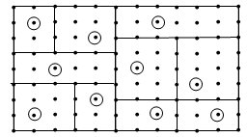
If a category is well selected, it will be reasonable to assume that if the program works correctly on one representative test case of a category, if works correctly on all test cases within that category.

Slide 78
No matter, how hard we try, how cleverly we plan, how much time we spend, and how many staff and computers we use, we still can not do enough testing. We still miss bugs. Some of the reasons are:
The domain of possible inputs is too large to test
There are too many possible paths through the program to test
The user interface issues (and thus the design issues) are too complex to completely test. If “3+3 should be 7” is written in specifications, and program gives output of 7 (instead of 6); is it a bug? Program is meeting specifications, but we know that the input is not correct. This is a trivial case & we know the answer. There may be many situations where answers are not that simple. Is it not a real challenge to handle many such nasty situations?

Slide 79
Measurement of the progress of testing
What is the status of testing ?
We count things
How to interpret such counts ?
Is experiencing more failures a good news or a bad ?
The answer could be either.

Slide 80
A high bug count could mean that testing was thorough and very few bugs remain. Or, it could mean that the software simply has lots of bugs and, even though many have been exposed, lots of them remain. These counts may be illusive and do not help us to measure the progress of testing.
When to release the software is a sensitive decision & should be based on the status of testing. Although in the absence of testing standards, “economics”, “time to market” and “gut feeling” have become important issues over technical considerations for the release of any software. Many reliability models are available with many limitations and are not universally acceptable.

Slide 81
Software companies are facing serious challenges in testing their products and these challenges are growing bigger as software grows more complex. The first & most important thing is to recognize the complex nature of testing and take it seriously. Researchers should also realize that companies are ready to fund good research ideas. However, they expect more practical and less academic work in order to implement immediately. We all should work hard to bridge the gap between academic research and real industry requirements. If we do so, problems shall be minimized & we may be able to develop standards for software testing.

Slide 82
Thank You

